Slide 1
Small Baseline Depth Estimation using Dual Pixels
Min Jun Kang | RCV lab MS
School of Electrical Eng.
Email : kmmj2005@kaist.ac.kr
지도교수. In So Kweon
http://rcv.kaist.ac.kr/

Slide 2
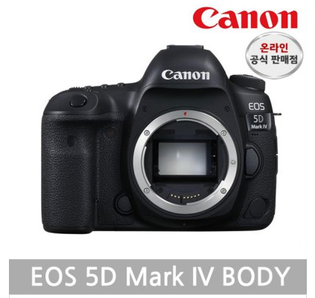
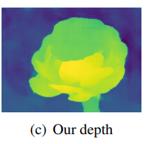
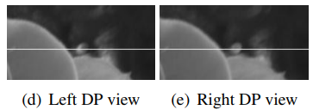
1. Baseline Papers
DNN
(Deep Neural Network)
Synthetic Depth of Field with a Single Camera Mobile Phone (SIGRAPTH 18)
Learning Single Camera Depth Estimation using Dual-Pixels (ICCV 19 oral)

Slide 3
2. Why do we need Canon Camera?
Dual Pixel Camera built in Equipments
1. Google Pixel 2,3 Phones
Not available to Dual Pixel’s Left Right Data !!
2. Samsung Galaxy Phones (>=7 version)
3. Canon camera EOS 5D MARK 4
Provide DPP(Digital Professional Photos 4) tool
with “Dual Pixel Optimizer” function.

Slide 4
3. Need Canon SDK/API !
Dual Pixel Optimizer function in API
(DP left right 데이터 뽑는 것의 자동화)
Auto handling of focal length, aperture, ISO, focal point.
(Depth 추출을 위해서 camera intrinsic, extrinsic calibration을 해야 하고 이를 위한 camera parameter 세팅을 자동으로 할 필요성이 있습니다.)
3. Mutli Camera Data Acquisition.
(2개 이상의 Camera를 이용해 사진을 동시에 취득했을 때 Data 취득 자동화가 필요합니다.)

